Slide 1
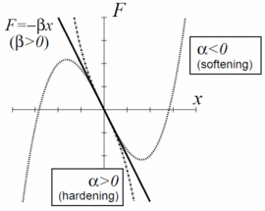
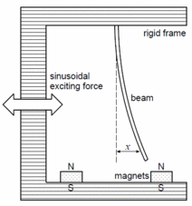
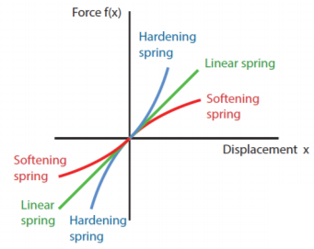
Andy Jeong, EE ’20
Prof. Raja
Ph235 Physics Simulations
Problem Statement
Examine and identify points of bifurcation in Duffing Oscillator through visual aids for softening and hardening duffing oscillator system
Figure 1. For β>0: a forced oscillator model with a spring
whose restoring force is written as F=−βx−αx3
Figure 2. For β<0: a model of a periodically forced steel beam
which is deflected toward the two magnets.
(Moon and Holmes, 1979; Guckenheimer and Holmes, 1983; Ott, 2002)
Spring System
Notes:
Softening system numerical solution caused some trouble in approximation
So worked with hardening system mostly
Mass = 1 kg

Slide 2
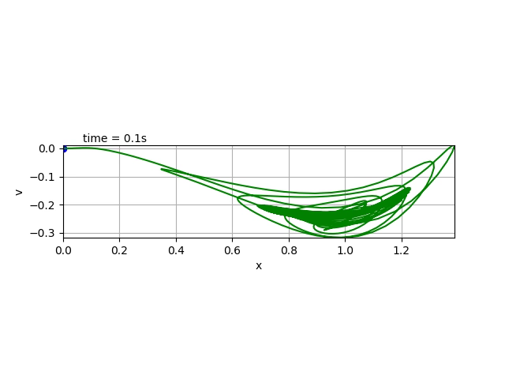
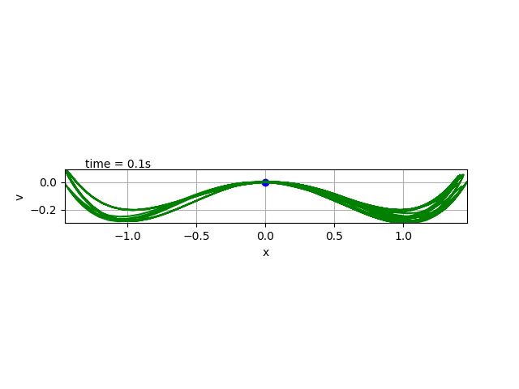
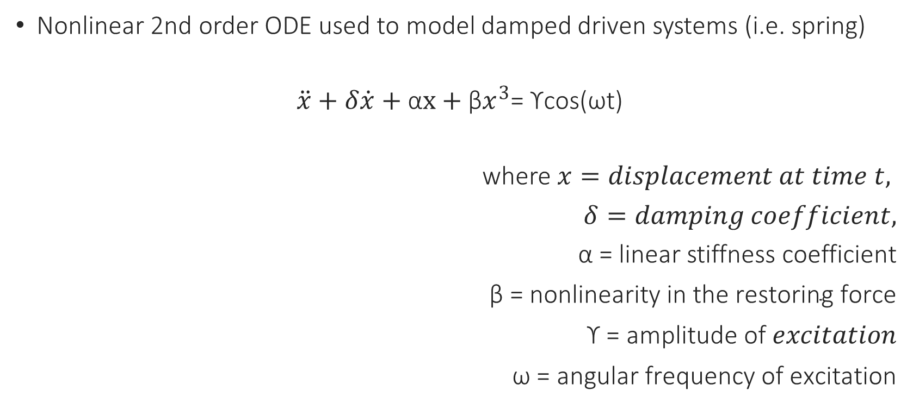
Duffing Oscillator (Equation)
Andy Jeong, EE ’20
Prof. Raja
Ph235 Physics Simulations
Nonlinear 2nd order ODE used to model damped driven systems (i.e. spring)
$\ddot{x}+δ\dot{x}+\text{α}x+{\text{β}x}^{3}$= ϒcos(ωt)
where$x=displacement at time t,$
$δ=damping coefficient,$
$\text{α}\text{ =}$ linear stiffness coefficient
$\text{β}\text{ = }\text{nonlinearity} \text{in} \text{the} \text{restoring} \text{force}$
$\text{ϒ}\text{ = }\text{amplitude} \text{of} excitation$
$\text{ω}\text{ = }\text{angular} \text{frequency} \text{of} \text{excitation}$

Slide 3
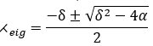
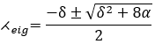
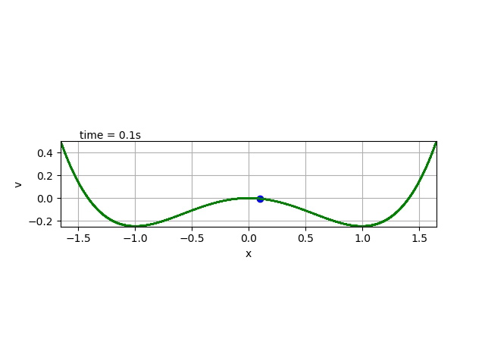
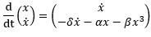
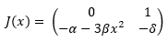
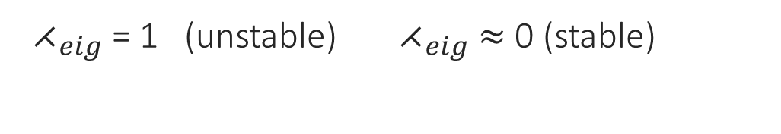
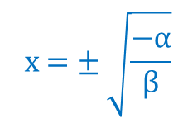
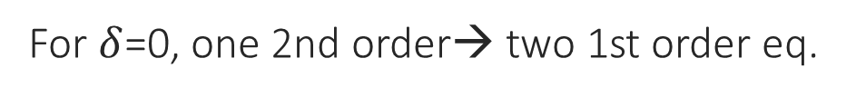

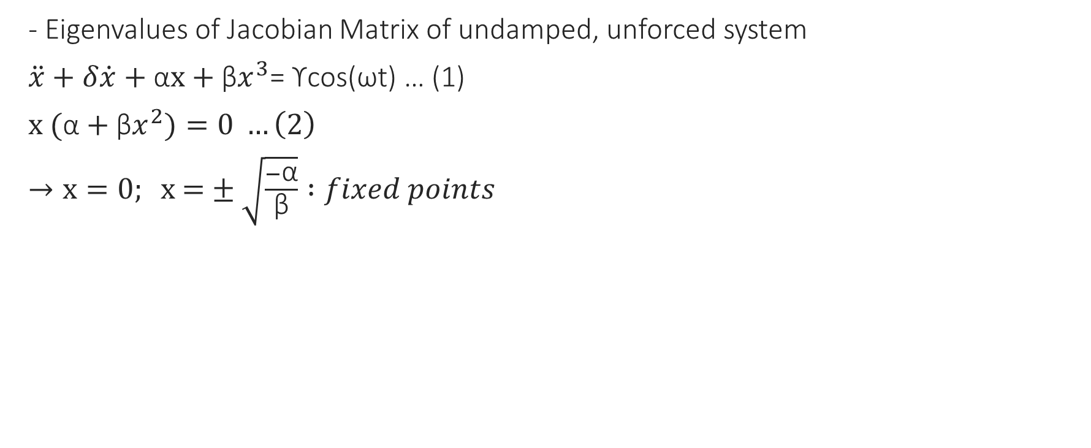
Stability Check
Andy Jeong, EE ’20
Prof. Raja
Ph235 Physics Simulations
- Eigenvalues of Jacobian Matrix of undamped, unforced system
$\ddot{x}+δ\dot{x}+\text{α}x+{\text{β}x}^{3}$= ϒcos(ωt) … (1)
$x \text{(}\text{α}+{\text{β}x}^{2})=0 …\left(2\right)$
$→x=0; \text{x}\text{ =}±\sqrt{\frac{−\text{α}}{\text{β}}} :fixed points$
$$\text{x}\text{ =}±\sqrt{\frac{−\text{α}}{\text{β}}}$$
$$x=0$$
${ ⋌}_{eig}$ = 1 (unstable) ${ ⋌}_{eig}$ $≈$ 0 (stable)
For $δ$=0, one 2nd order→ two 1st order eq.
Notes:
(2) No net force (conservation of energy)
at x = 0 , always equilibrium point (fixed point) exists
at x= +/- sqrt(-alpha/beta), two equilibria appear. → Jacobian
Jacobian: take derivative w.r.t. x and x’

Slide 4
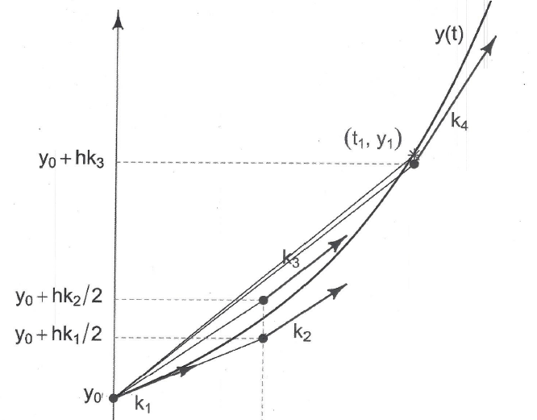
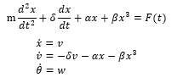
Numerical Approximation
Andy Jeong, EE ’20
Prof. Raja
Ph235 Physics Simulations
Methods: Fourier Series, Frobenius method, Homotopy analysis method (HAM)
4th order Runge-Kutta Method
Table 1 Fourth-order Runge-Kutta Implementation Verification^{[1]}
Step size (h) | Approximation of x at t = 0.1, x_{approx} | Final Global Error(F.G.E) at t = 0.1 (x_{approx}- x_{true}) | Error Ratio
0.1 | -0.0018921715207243900 | -0.0000000076565361900 | -
0.05 | -0.0018921642988212700 | -0.0000000004346330700 | 17.6
0.025 | -0.0018921638899839600 | -0.0000000000257957601 | 16.8
0.0125 | -0.0018921638657577500 | -0.0000000000015695500 | 16.4
0.0001 | -0.0018921638641882000 (=x_{true}) | (assume true value) | (Converges to 16)
Figure 3. RK4 Method
Notes:
Since Duffing equation does not admit an exact symbolic solution,
Can use approximation methods numerically to determine solutions.

Slide 5
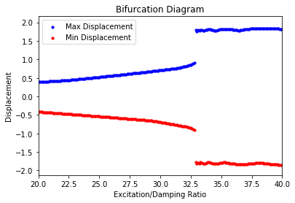
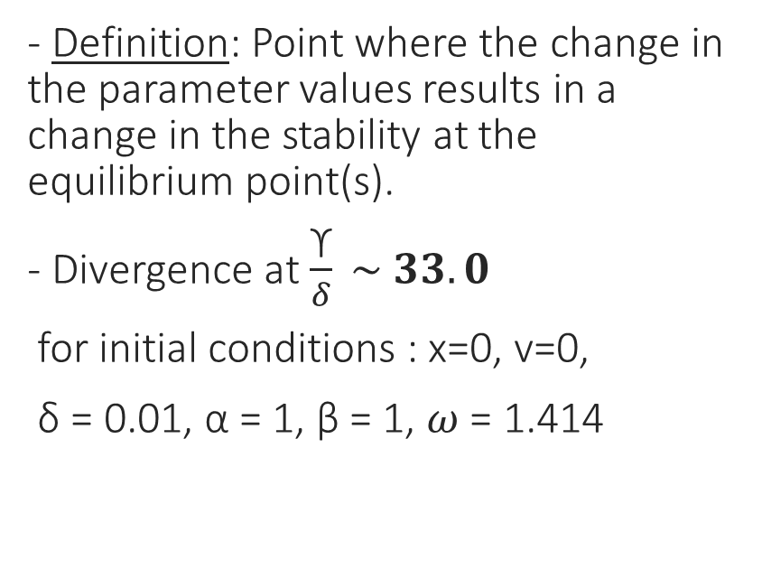
Bifurcation
Andy Jeong, EE ’20
Prof. Raja
Ph235 Physics Simulations
- Definition: Point where the change in the parameter values results in a change in the stability at the equilibrium point(s).
- Divergence at$\frac{\text{ϒ}}{δ} \sim 33.0$
for initial conditions : x=0, v=0,
δ = 0.01, α = 1, β = 1, $ω$ = 1.414
$\text{ϒ}$: harmonic excitation force$, δ$: damping coefficient, α: linear stiffness, β : nonlinearity coefficient, $ω$: angular frequency

Slide 6
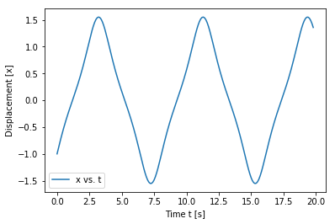
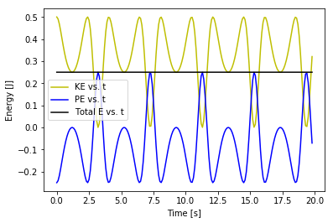
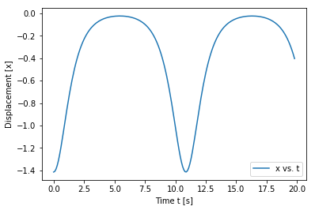
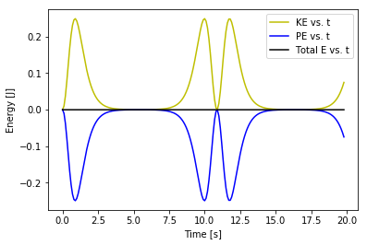
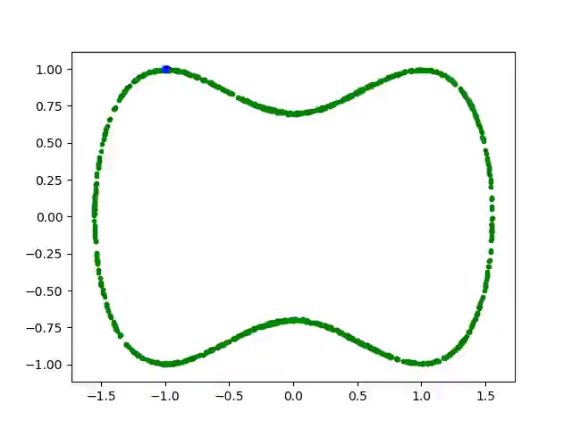
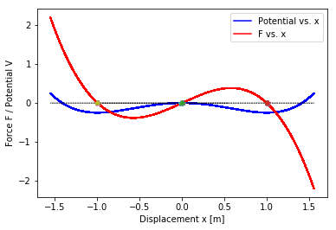
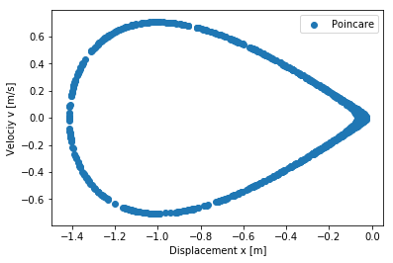
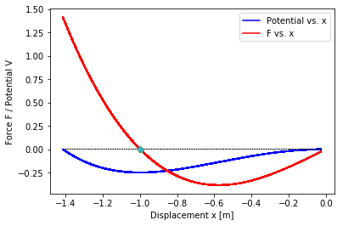

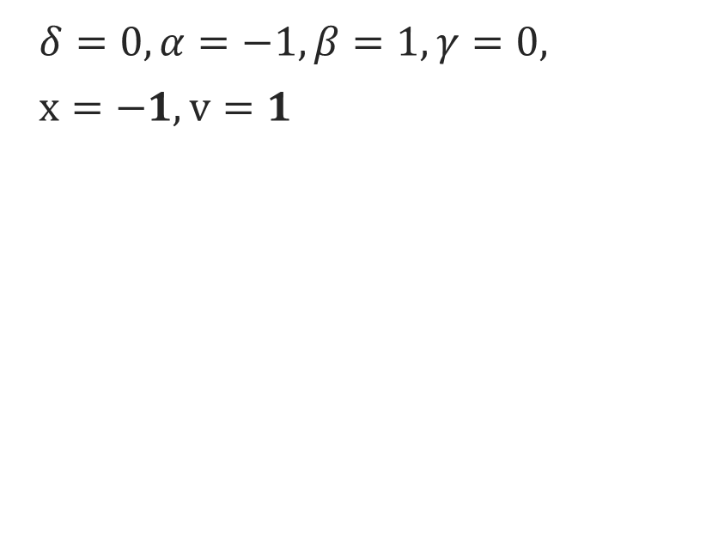
Free motion
Andy Jeong, EE ’20
Prof. Raja
Ph235 Physics Simulations
Initial Conditions change
→ Fixed point changes (-1, 0, 1 → -1 only)
$δ=0, α=−1,β=1,γ=0,$
$x=−1, v=1$
$$δ=0, α=−1,β=1,γ=0, \\ x=−1.414, v=0$$

Slide 7
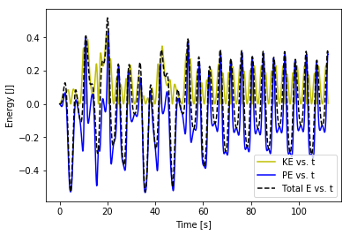
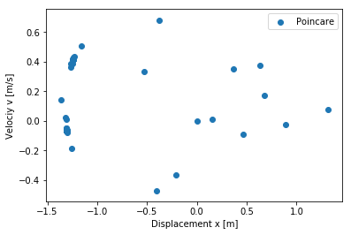
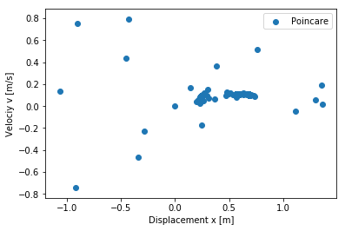
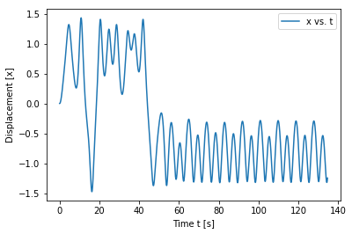
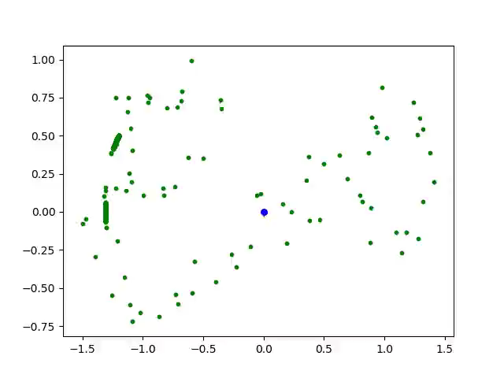
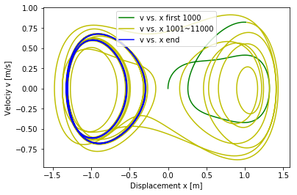
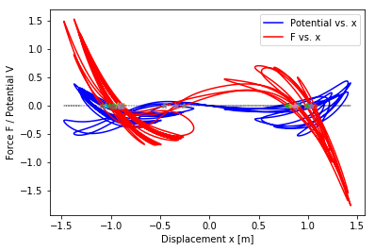
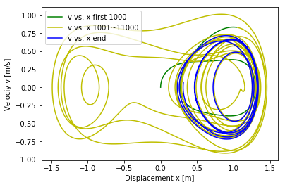
Damped Driven Motion
Andy Jeong, EE ’20
Prof. Raja
Ph235 Physics Simulations
* Small change → changes limit cycle to converge at a different fixed point
$δ=0.1, α=−1,β=1,γ=0.32,ω=1.4$ $γ=0.3$4
$x=0, v=0$

Slide 8
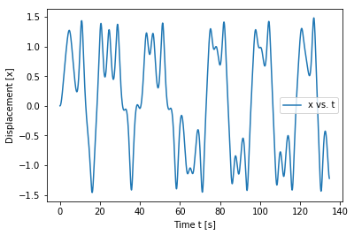
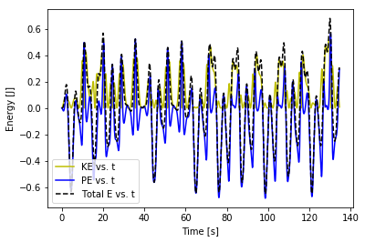
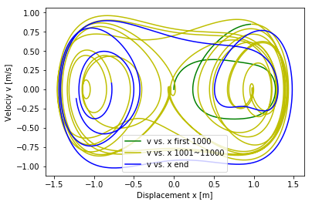
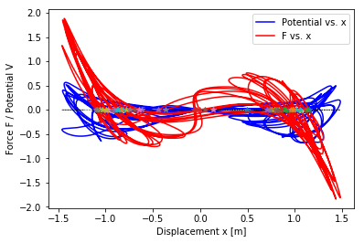
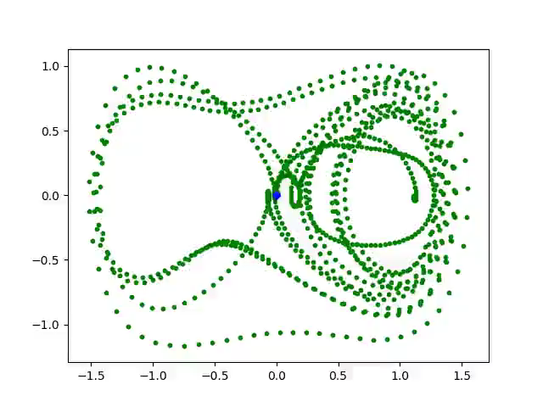
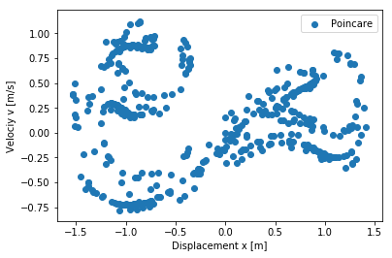
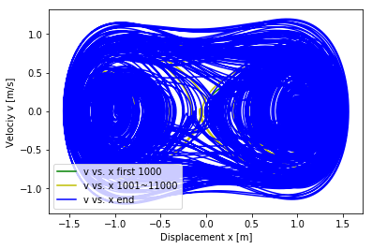
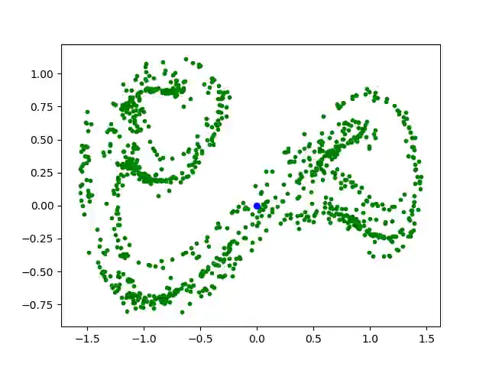

Damped Driven Motion: Chaos
Duffing Oscillator (Equation)
Andy Jeong, EE ’20
Prof. Raja
Ph235 Physics Simulations
$δ=0.1, α=−1,β=1,$
$γ=0.38,ω=1.4$, $x=0, v=0$
“Strange Attractor”

Slide 9
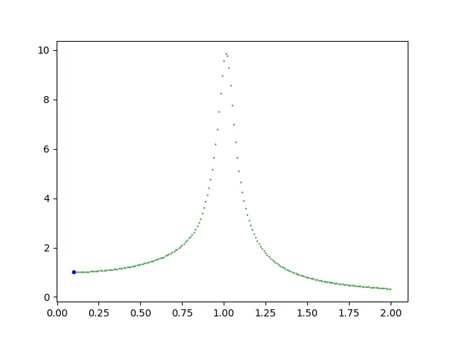
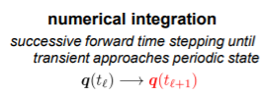
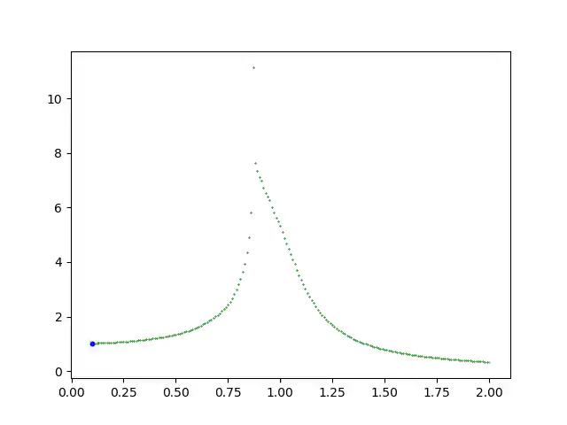
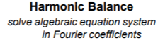
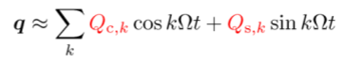
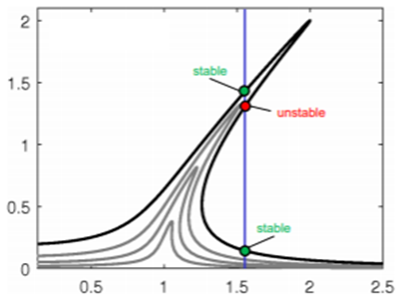


Frequency Response
Andy Jeong, EE ’20
Prof. Raja
Ph235 Physics Simulations
* approach: harmonic balance method
(i) Linear System (point of bifurcation)
(ii) Softening System
(iii) Hardening system
(i)
(ii)
Hysteresis! (loop)
(iii)
Notes:
Image ref for the methods:
https://www.ila.uni-stuttgart.de/nlvib/downloads/HB_NLvib_presentation.pdf

Slide 10


Andy Jeong, EE ’20
Prof. Raja
Ph235 Physics Simulations
Conclusion
Duffing Oscillator governing a rather simple nonautonomous system (i.e. spring, pendulum) can exhibit drastic change in its dynamical behavior by small perturbations in initial conditions and/or parameters
Periodic doubling (System’s period = N * Period of applied force, where N $=even$) causes bifurcation and thus chaotic motion (Lyapunov exponent > 0)
Interesting changes: hysteresis effect in frequency domain, change in stable equilibrium (fixed) points and limit cycles,
Notes:
Softening system numerical solution caused some trouble in approximation
So worked with hardening system mostly
Mass = 1 kg

